Slide 1
Developing Southern African Climate Index
Participants
Irene Nandutu (Rhodes University)
Malesela Simon Mokhanda (AIMS South Africa)
Abrange Mavimbele (AIMS South Africa)
Shardav Bhatt (Navrachana University, Baroda, India)
Prof Dhanesh Patel (M.S.University of Baroda, India)
Dr.Mrudula Trivei (M.S.University of Baroda, India)
Dr Shariffah Suhaila Syed Jamaludin (UTM, Malaysia)
Academic Advisors
Prof Montaz Ali (Wits University)
Dr Syamala Krishnannair(University of Zululand, SA)
Industry Advisor
Prof Jennifer Fitchett​ (University of the Witwatersrand) ​

Slide 2
Introduction
The role of climate in Tourism
Selection of destination
Timing of bookings and peak season
Enjoyment of the vacation and ability to take part in activities
_______________________________________________________
Bad weather can serve as a deterrent to future visitors
Severe climatic events can destroy infrastructure and prevent access to a destination

Slide 3
Introduction....Cont
Climate Suitability for Tourism
defined by:
Temperatures within human comfort levels
No rainfall
Low wind speed
Low humidity
Little to no cloud cover
Maximised sunshine hours
TCI formula: TCI = 2(4CD+CA+2R+2S+W)(Mieczkowski, 1985)
CD = daytime thermal comfort
CA = average thermal comfort
R = total monthly rainfall
S = total monthly sunshine hours
W = monthly average wind speed

Slide 4
Introduction....Cont
Variables determining Destination Attractiveness Index
Climate
Absence of Extreme climatic situations
Scenetic Beauty
Accessibility and Infrastructure Availability
Image of the Country and Safety
Food and Hospitality services
Shopping Envt.
Culture, Heritage and Uniqueness
Service Product Mix
Customer Services and Support
Value for money perception
Customised travel packages
1.Climate
2. Nature
3. Destination Environment
4. Destination Marketing Mix

Slide 5
Introduction....Cont
Other Climate Index developed
Because of a variety of tourist attactions and activities
A new customized climate indices are developed
HCI –Holiday Climate Index (Scott et al., 2016)
HCI = 4 (TC) + 2. CC +3. R + W
BCI-Beach Climate Index (Morgan et al., 2000)
BCI = 0.18 · TC + 0.29 · R + 0.26 · W + 0.27 · S
CCI-Camping Climate Index (Ma et al., 2020)
CCI = 0.5*TC + 0.5*S

Slide 6
Introduction....Cont
Motivation
None of these indices is developed using African data
Yet Africa has different whether patterns compared to European countries
Why South African TCISA?
Determine climate suitability for Tourists
Increase on Tourists Tourism experience
Contribute to boosting the economy of the country

Slide 7
Data Collection

Slide 8
Data
Webscraping
Database: https://climexp.knmi.nl/start.cgi
Towns: Duban, Capetown
Climate Elements
Trip Advisor
Opinion of Tourists
Variables Selected
Maximum Temperature (X1)
Minimum Temperature (X2)
Precipitation (X3)
Cloud cover (X4)
Wind Speed (X5)
Why?
To develop a TCISA

Slide 9
Data
TCISA Formula
The TCI_{SA} score is calculated based on the following formula:
TCI_{SA} = X­₁ + X₂ +X₃ +X₄+X₅ (1)
X­₁ - Maximum Temperature (ºC)
X₂ – Minimum Temperature (ºC)
X₃ – Precipitation (mm)
X₄ – Cloud Cover (%)
X₅ – Wind Speed (km/hr)

Slide 10
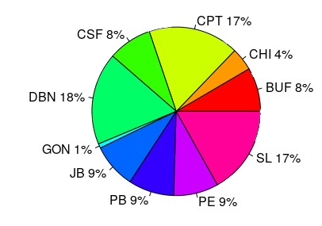
Data Analysis – Climate Elements Dataset
Considers_Weather vs Don’t Cosider Weather
Proportions of Destination Weather Consideration before Travel
Proportions of Destination Weather Consideration before Travel
People who considere weather as important factor before travelling
to Cape Town and Durban

Slide 11
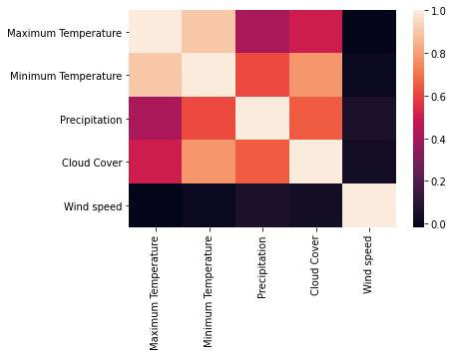
Data Analysis – Climate Elements Dataset
Durban (1905-2019)

Slide 12
Data Analysis – Trip Advisor Dataset
464 climate reviews have been recorded
Almost 40% of tourists have commented on ‘cold’ weather
30% of them are very sensitive to ‘hot’ weather
Rainy day and Sunny day (10-11%)

Slide 13
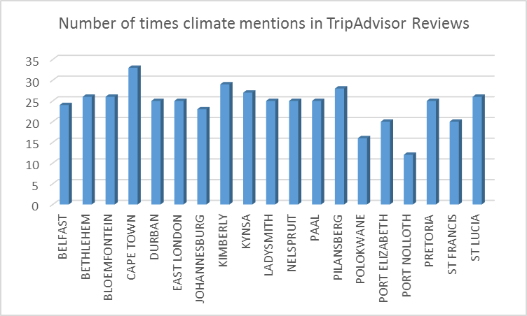
Data Analysis – Trip Advisor Dataset
Figure shows the number of climate references made by tourists to specific destinations. Tourists in Cape Town have the highest number of times climate mentions, while the lowest is in Port Nolloth.

Slide 14
Data Analysis – Trip Advisor Dataset
Almost all 19 destinations in South Africa seemed to have received comments on 'cold' weather.
The greatest number of comments were made by the tourists who visited Bethlehem about the cold weather. On the other hand, comments on 'hot' weather were recorded in Kimberly.

Slide 15
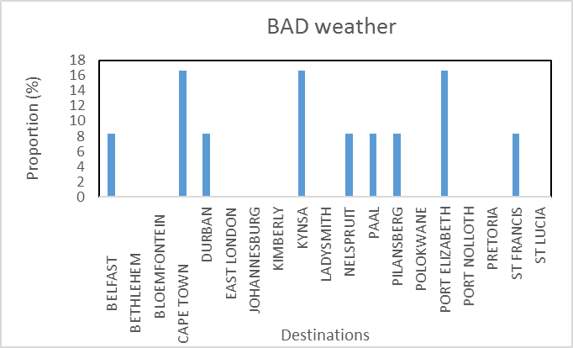
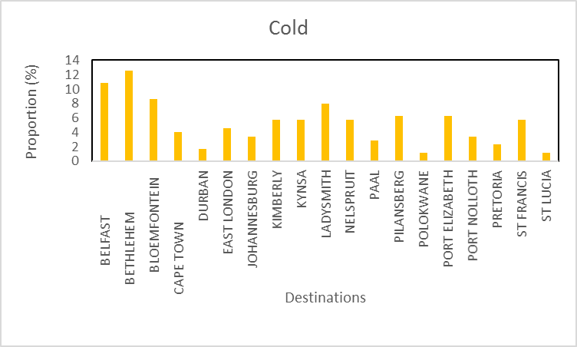
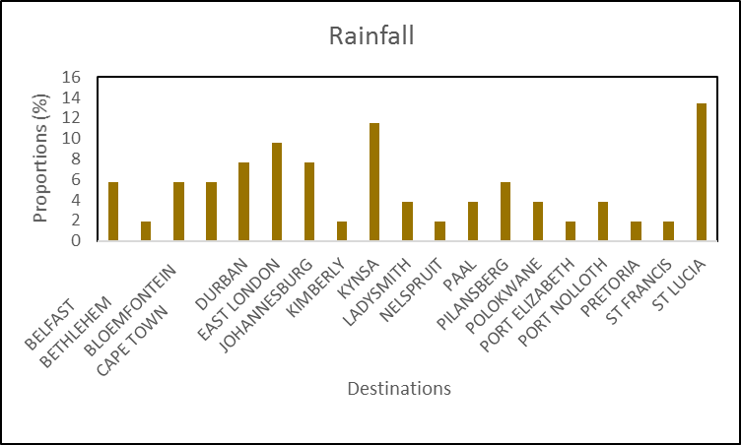
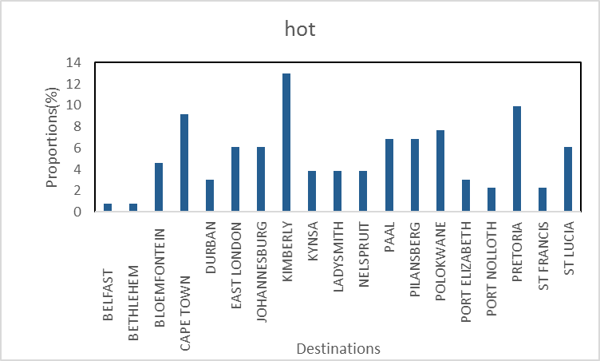
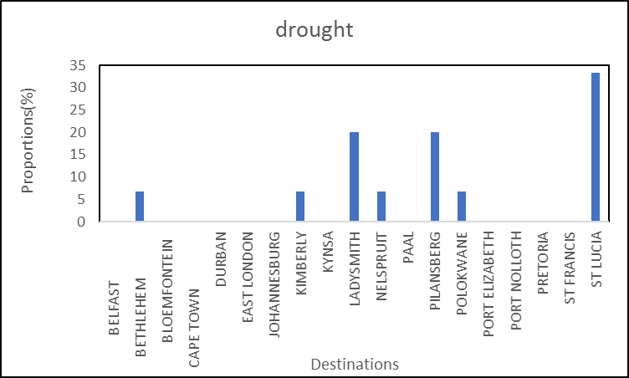
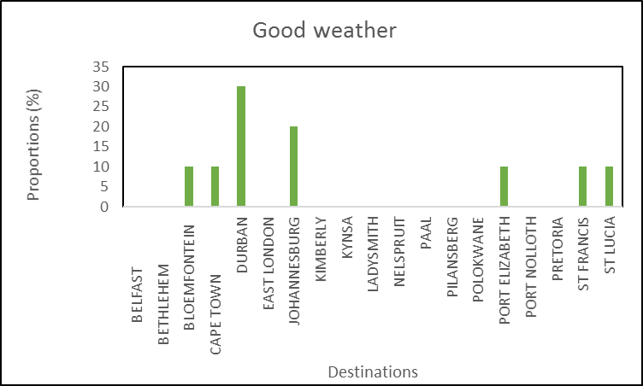
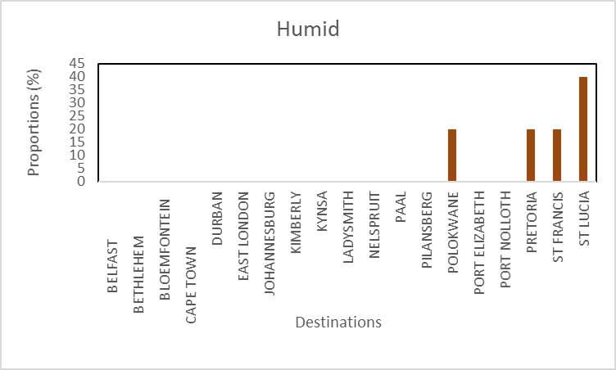
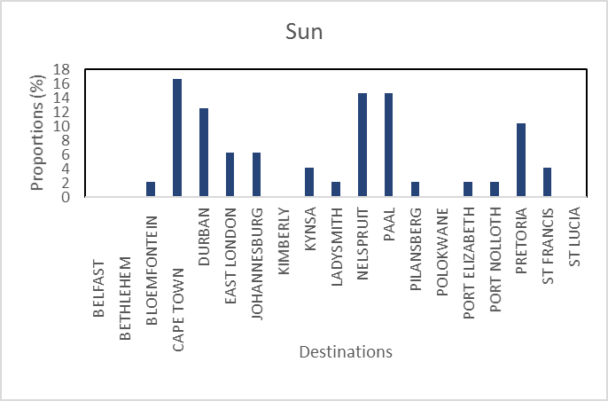
Data Analysis – Trip Advisor Dataset

Slide 16
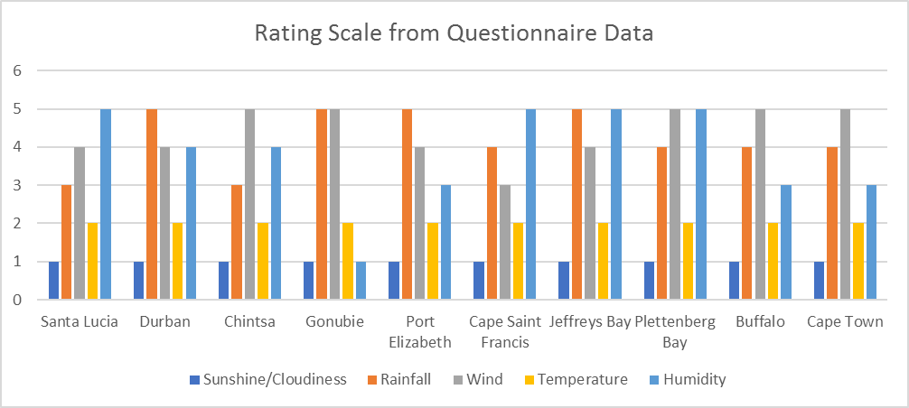
Data Analysis – Questionnaire
Scale
1- highest
5 -lowest
Based on the questionnaire data, the tourists give the highest rating on sunshine/cloudiness, followed by temperature. Their lowest rating is on rainfall.

Slide 17
Data Analysis – Questionaire
The sensitivity of tourists to the weather of each destinations may give some indications of the climate suitability of the destinations. Here, we conduct a statistical analysis using the contingency table to determine the link between the climate reviews and the destinations.
Ho: The climate reviews made by the tourists are not associated with the destinations
H₁: The climate reviews made by the tourists are associated with the destinations
For the test hypothesis, a chi-square test was performed. A –p value 0.000, which is less than 5% of the significance level is observed. We therefore conclude that the climate reviews made by the tourists are linked to the destination. In other words, it means that tourists have become aware of the climate.

Slide 18
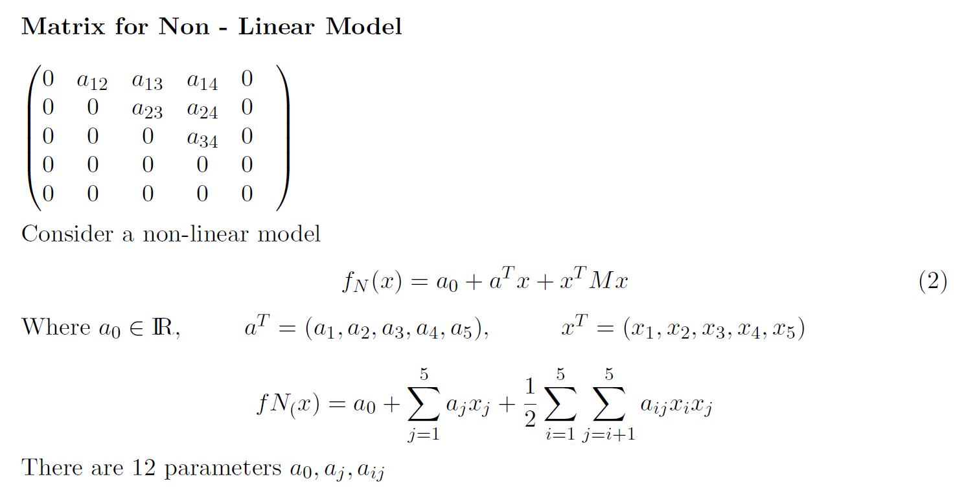
Mathematical Model
TCI for SA is calculated using following variables.

Slide 19
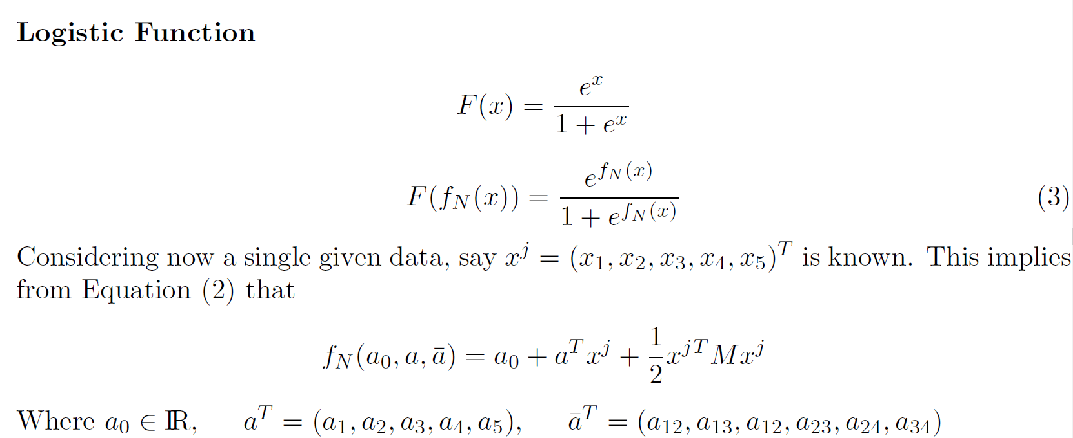
Mathematical Model

Slide 20
Mathematical Model

Slide 21
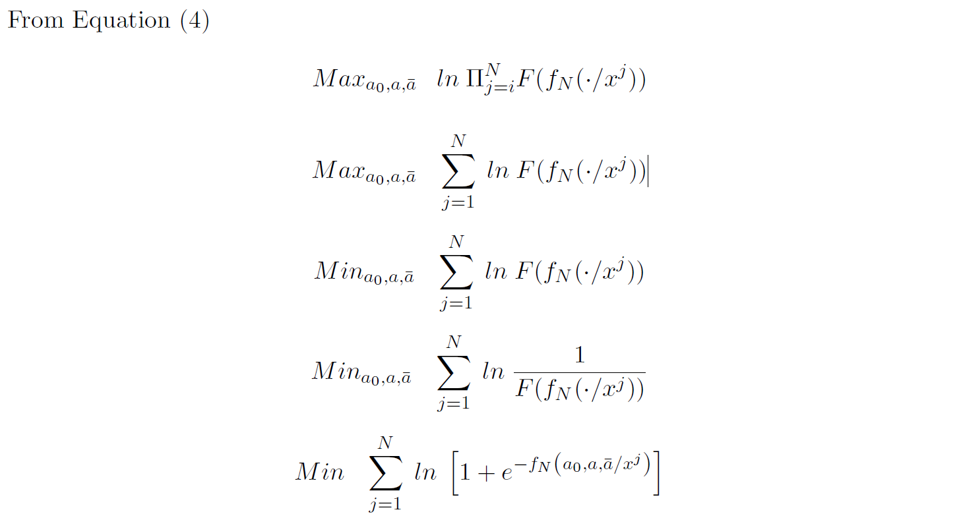
Mathematical Model

Slide 22
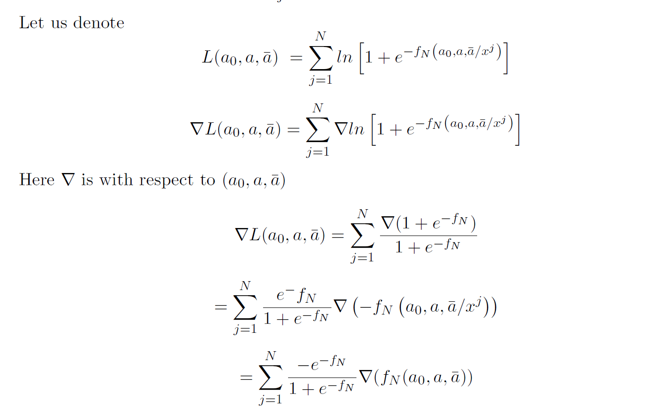
Mathematical Model

Slide 23
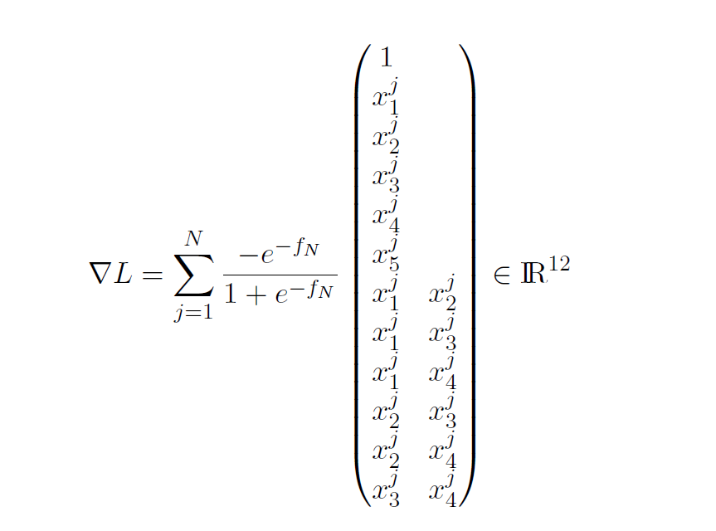
Mathematical Model
$∴$

Slide 24
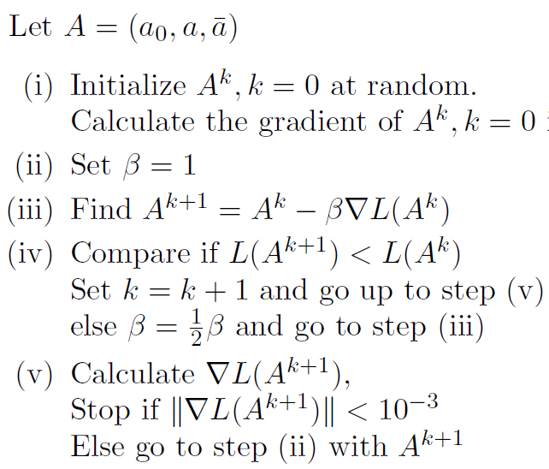
Optimization Procedure

Slide 25
Estimation of TCI

Slide 26
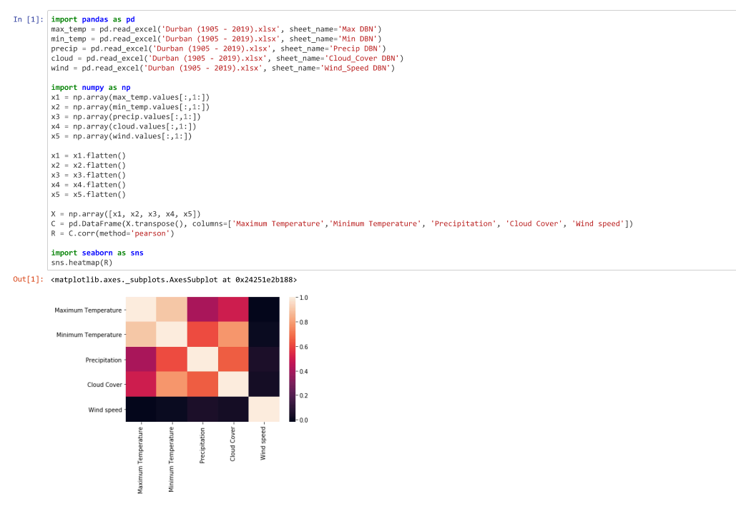
Results and Discussion

Slide 27
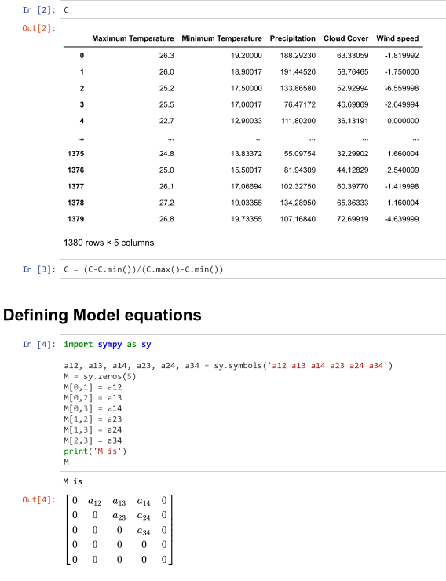
Results and Discussion

Slide 28
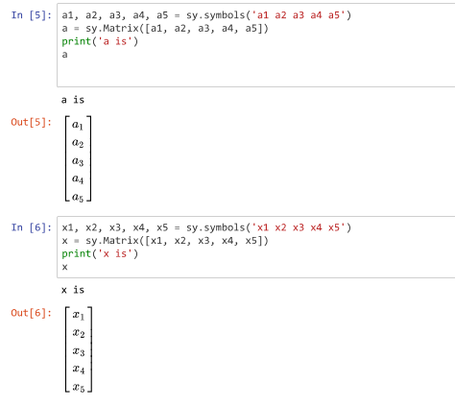
Results and Discussion

Slide 29
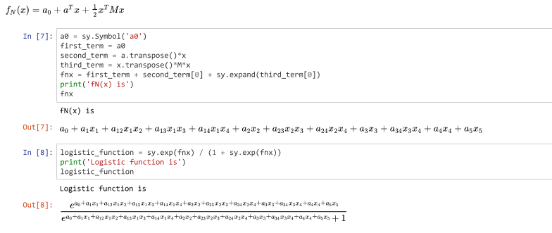
Results and Discussion

Slide 30
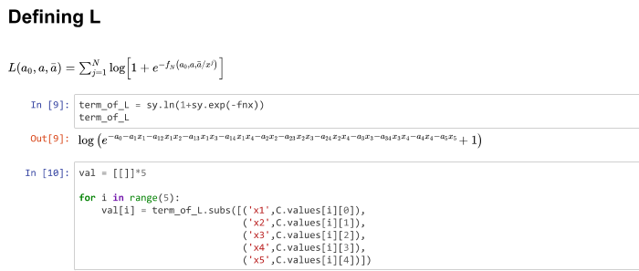
Results and Discussion

Slide 31
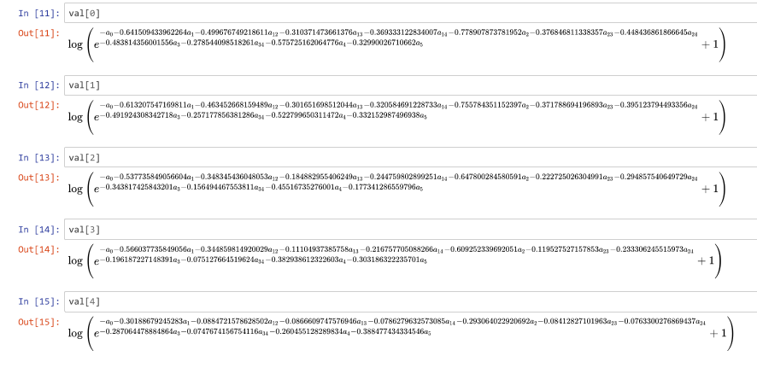
Results and Discussion

Slide 32
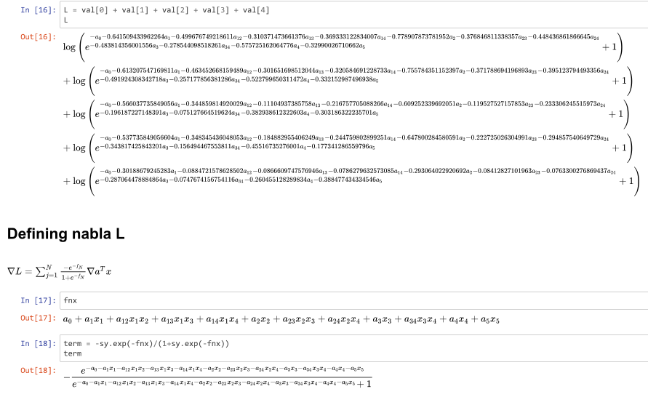
Results and Discussion

Slide 33
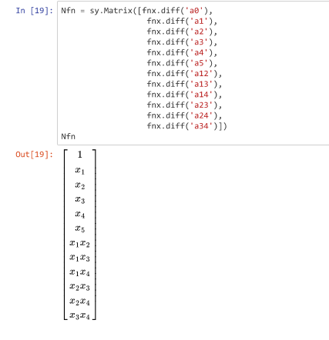
Results and Discussion

Slide 34
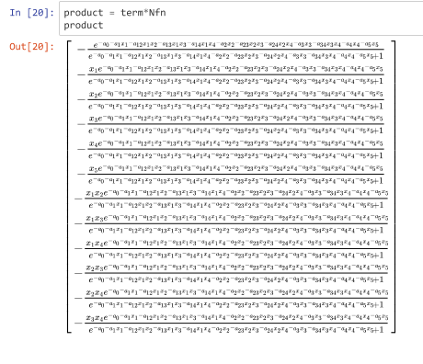
Results and Discussion

Slide 35
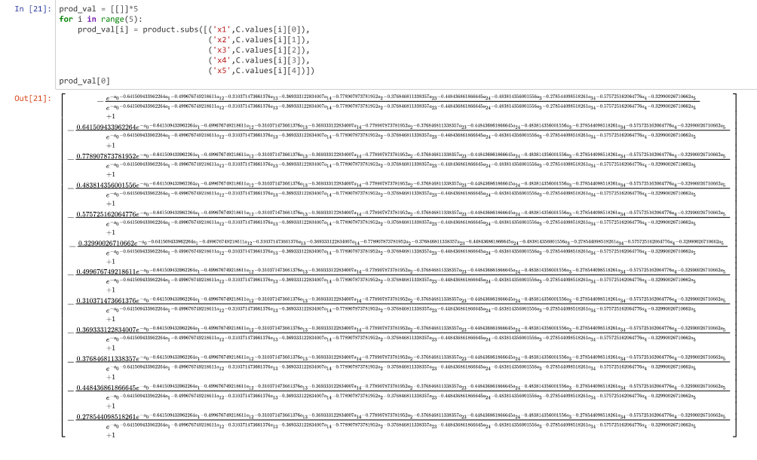
Results and Discussion

Slide 36
Results and Discussion

Slide 37
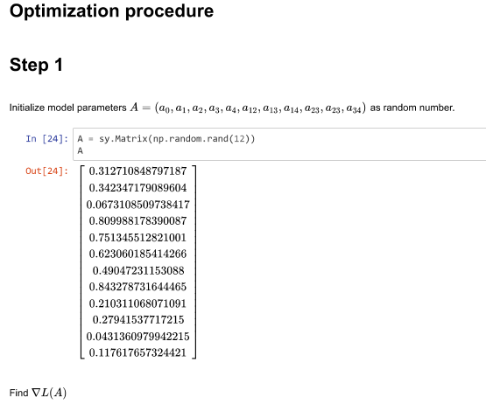
Results and Discussion

Slide 38
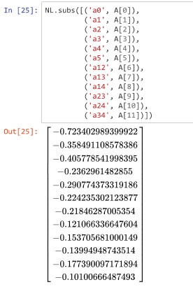
Results and Discussion

Slide 39
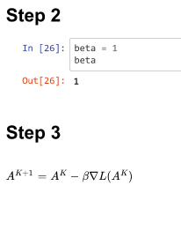
Results and Discussion

Slide 40
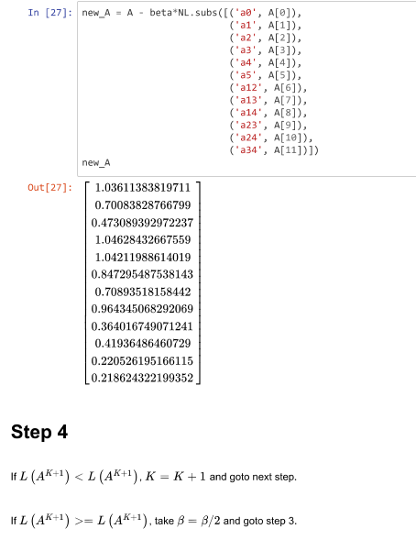
Results and Discussion

Slide 41
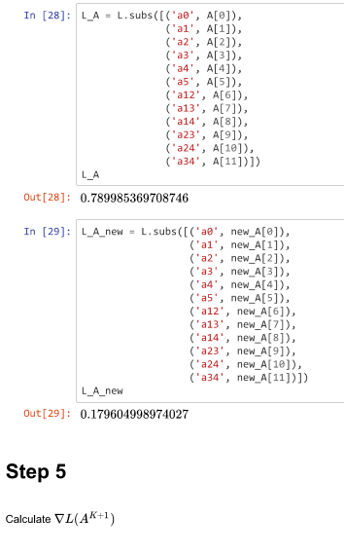
Results and Discussion

Slide 42
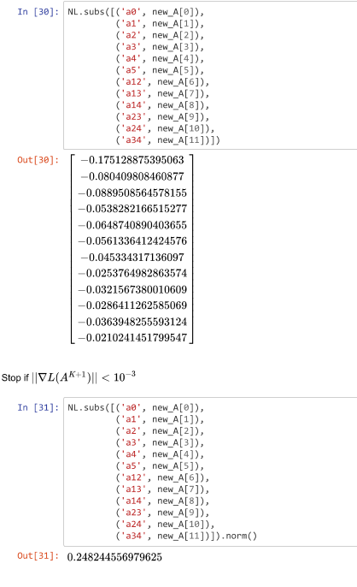
Results and Discussion

Slide 43
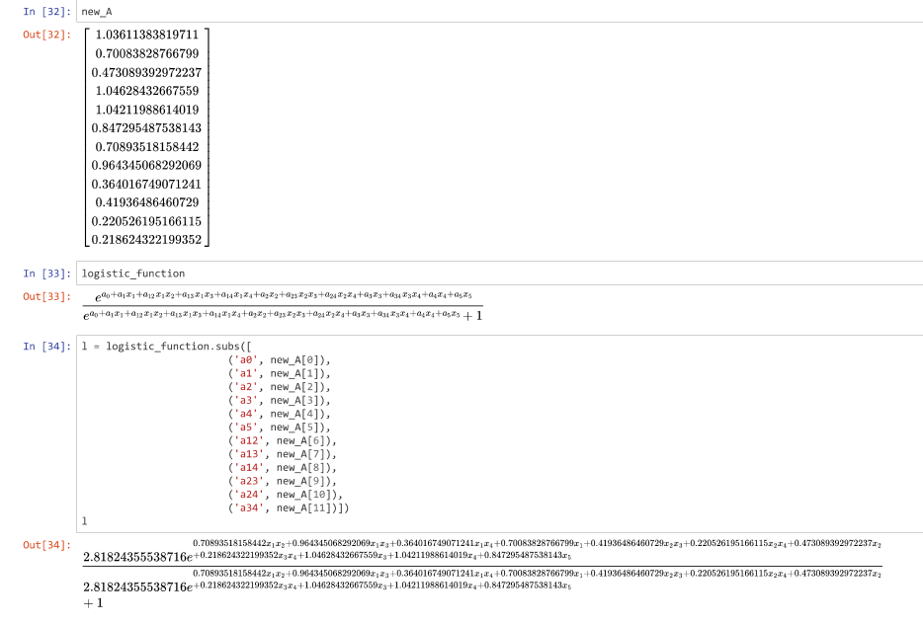
Results and Discussion

Slide 44
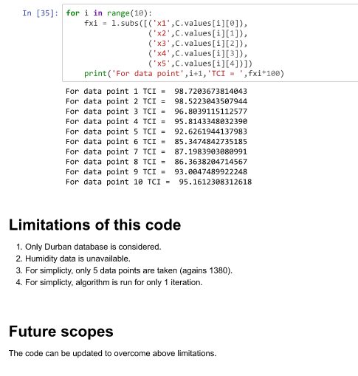
Results and Discussion

Slide 45
Results and Discussion
Database for Durban city was considered for years 1905-2019 for 5 parameters: Max/Min temperature, Precipitation, Cloud cover and wind speed.
5x5 Correlation matrix between these parameters was constructed.
Non-linear model was developed based on 12 parameters: 5 for each parameter, 6 for pair of parameters and 1 constant.
Logistic function was used to determine the objective function.
Optimization procedure discussed.
We tried to create a python code for the optimization procedure.
5 data points and 1 iteration was considered in the code.

Slide 46
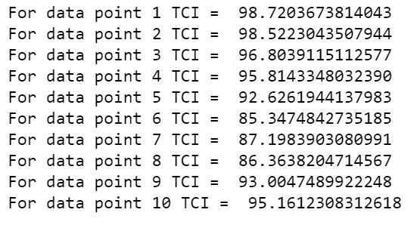
Results and Discussion

Slide 47
Results and Discussion
Limitations of this code:
1. Only the Durban database is considered.
2. Humidity data is unavailable.
3. For simplicity, only 5 data points are taken (against 1380).
4. For simplicity, the algorithm is run for only 1 iteration.
The code can be updated to overcome above limitations.

Slide 48
Conclusions & Recommendations
In this study a mathematical model is proposed to estimate the TCISA index for South Africa
Five climate indices are used as an input for the model
The proposed model will be validated using the climate data for Durban , Cape Town , St.Lucia and other regions in SA
Development of Holiday Climate Index, Beach Climate Index and CCI-Camping Climate Index for South Africa are recommended
Customized TCISA index to integrate tourist’s opinions as part of the thermal comfort factors
The effect of other climatic indices such as “Humidity” , “Sunshine” and ‘’Extreme weather patterns” in tourism can be of interest to specify the tourist’s popular destinations in SA
Use of nonlinear statistical model and ML techniques are recommended to handle the multicollinearity of climatic indices in the estimation of TCI

Slide 49
References
Siyao Ma , Christopher A. Craig & Song Feng (2020): Camping climate
resources: the camping climate index in the United States, Current Issues in Tourism, DOI:10.1080/13683500.2020.1846503
Mieczkowski (1985) The Tourism Climate Index: A Method of Evaluating World Climates for Tourism
Daniel Scott, Michelle Rutty, Bas Amelung and Mantao Tang (2016) An Inter-Comparison of the Holiday Climate Index (HCI) and the Tourism Climate Index (TCI) in Europe
R.Morgan, E.Gatell, R.Junyent, A.Micallef, E.Ozhan \& A.T.Williams (2000) An improved user-based beach climate index

