Slide 1
Melanoma and Breast cancer
Interview with Lauren Segal
15th March 2018

Slide 2
Top 5 cancers -South Africa
Breast , cervix ,Unknown Primary , Colorectal cancer and Uterus. Breast cancer 22%.
Life time risk 1:28; white women 1:11 and black 1:51.
Breast cancer is 2nd below cervix as cause of death.

Slide 3
Association between female breast cancer and cutaneous melanoma. Goggins W et al.Int J Cancer. 2004 Sep 20;111(5):792-4.
Among young [breast cancer] patients, we observed a 46% elevated risk of a second [cutaneous melanoma]. Women who underwent radiation therapy exhibited a 42% increased risk for [cutaneous melanoma].
Above found that breast cancer survivors were 16% more likely to develop cutaneous melanoma than women who have not had breast cancer. And female melanoma survivors had an 11% increased risk of being diagnosed with breast cancer as second cancer.

Slide 4
Archives of Dermatology, 2011
This study found that female breast cancer survivors younger than 45 years old had a 1.38 relative risk (or 38% increase from the general population) of developing melanoma as a second cancer. Female breast cancer patients 45 years and older had a 12% increase in the risk for being diagnosed with melanoma.

Slide 5
What Can We Do?
Lifestyle changes like quitting smoking , maintaining a healthy weight, exercising, and minimizing alcohol intake can help reduce breast cancer risk. To detect breast cancer early, women over 40 should get yearly mammograms and all women should conduct monthly breast self-exams.

Slide 6
What Can We Do?
If you think you are a candidate for BRCA2 or CDKN2A gene testing based on family or personal history, consider talking to your doctor or genetic counsellor. The BRCA2 gene substantially increases a breast cancer survivor’s risk of melanoma and the CDKN2A gene increases a melanoma survivor’s risk of breast cancer

Slide 7
Breast Cancer Risk Factors
Family history and personal characteristics
Family history - especially in a first-degree relative (parent, child, or sibling).
About 2 times higher for women with one affected first-degree female relative and 3-4 times higher for women with more than one first-degree relative.
Risk is further increased when the affected relative was diagnosed at a young age or if the cancer was diagnosed in both breasts.

Slide 8
Genetic predisposition
Inherited mutations (genetic alterations) in BRCA1 and BRCA2, the most well-studied breast cancer susceptibility genes, account for 5%-10% of all female breast cancers, 5%-20% of male breast cancer, and 15%-20% of all familial breast cancers. 2% in Jewish families.
Risks for BRCA1 and BRCA2 mutation carriers are estimated to be as much as 70%.

Slide 9
Reproductive factors- Breastfeeding
Most studies suggest that breastfeeding for a year or more slightly reduces a woman’s overall risk of breast cancer, with longer duration associated with greater risk reduction. The risk of breast cancer was reduced by 4% for every 12 months of breastfeeding.

Slide 10
What can you do to decrease chance of getting cancer?

Slide 11
Obesity,
Obesity and Weight gain
Postmenopausal breast cancer risk is about 1.5 times higher in overweight women and about 2 times higher in obese women than in lean women.
Breast cancer risk was 16% higher in women with type II diabetes independent of obesity.
Weight gain also increases risk of postmenopausal breast cancer. A large meta-analysis recently concluded that each 5 kg (about 11 pounds) gained during adulthood increases risk of postmenopausal breast cancer by 11%.

Slide 12
Physical activity
Women who get regular physical activity have a 10%-20% lower risk of breast cancer compared to women who are inactive. however, even smaller amounts of exercise, including walking, appear beneficial.
Breast cancer risk was 14% lower among women who reported walking 7 or more hours per week compared to women who walked 3 or less hours per week .

Slide 13
Diet
Soy products –reduce risk.
That high levels of fruit and/or vegetable consumption may reduce the risk of HR- breast cancer. These findings are supported by studies linking lower breast cancer risk to higher blood levels of carotenoids (micronutrients found in fruit and vegetables).

Slide 14
Alcohol
Alcohol consumption increases the risk of breast cancer in women by about 7%-10% for each 10g (roughly one drink) of alcohol consumed per day on average.
Women who have 2-3 alcoholic drinks per day have a 20% higher risk of breast cancer compared to non-drinkers.
There is also evidence that alcohol consumption before first pregnancy may particularly affect risk.

Slide 15
Tobacco
Smoking may slightly increase breast cancer risk, particularly long-term, heavy smoking and among women who start smoking before their first pregnancy.
A review by American Cancer Society researchers found that women who initiated smoking before the birth of their first child had a 21% higher risk of breast cancer than women who never smoked.

Slide 16
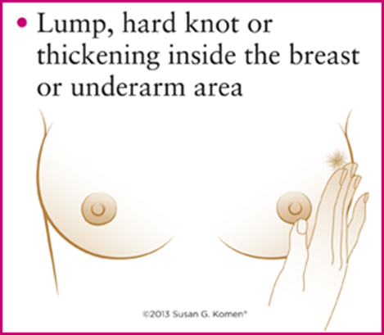
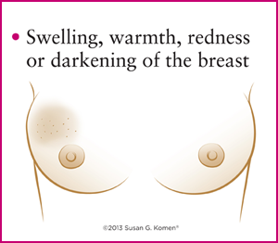
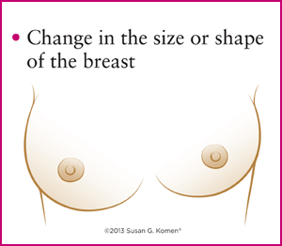
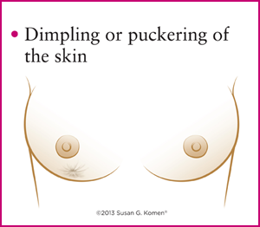
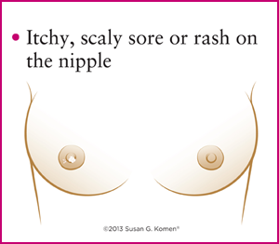
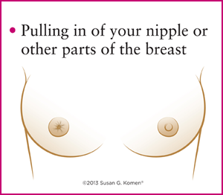
Signs to look for

Slide 17
Screening Recommendations *
1. Women with an average risk of breast cancer should undergo regular screening mammography starting at age 45 years (strong recommendation).
Women who are age 55 and older should transition to biennial screening or have the opportunity to continue screening annually (qualified recommendation).
2. Women should continue screening mammography as long as their overall health is good and they have a life expectancy of 10 years or more (qualified recommendation).
3. The American Cancer Society does not recommend clinical breast examination for breast cancer screening among average-risk women at any age (qualified recommendation).
A strong recommendation conveys the consensus that the benefits of adherence to that intervention outweigh the undesirable effects that may result from screening.
Qualified recommendations indicate there is clear evidence of the benefit of screening but less certainty about either the balance of benefits and harms.

Slide 18
Positive attitude in cancer: patients' perspectives. Wilkes LM et al. Oncol Nurs Forum. 2003 May-Jun;30(3):412-6.
For patients, positive attitude was defined as optimism for the day and getting though everyday events of the journey by taking control rather than focusing on the future. Factors that affected patients' positive attitude were their relationships with their specialists, people around them being positive and supportive, and having a pleasant environment at home and at the treatment centre.
Patients found expectations of them to be positive as being detrimental.

